Slide 1
Industrial Economics PPT - 18
Inflation and Unemployment
Features, Types and Effects
(Note: This is the PPT which I prepared for my class, I’ll be uploading additional notes for your reference)

Slide 2
Learning Objectives & Outcomes
How is inflation measured
Why do we have inflation
How is unemployment measured
Why do we have unemployment
2

Slide 3
Newspaper Article:
Core inflation: CPI inflation eases to 6.58%: Experts say RBI may go for up to 50 bps rate cut - The Economic Times (indiatimes.com)
India's retail inflation accelerated to 6.58 per cent in February, government data showed on Thursday, lower than the 6.80 per cent.
Different Views on Inflation:
1) Garima Kapoor, Economist-Institutional Equities, Elara Capital
Monetary Policy Committee (MPC) is expected to deliver a 35 bps repo rate cut on April 3. While today's CPI print of 6.58% remains marginally above the Reserve Bank of India's projected rate of 6.5% for Q4FY20, an expected moderation in headline print following crude oil's historic meltdown would provide the RBI a much-needed space to address growth slowdown that are likely to be amplified amid rising risks of global recession.

Slide 4
2) Madhavi Arora, Lead Economist, Fx And Rates, Edelweiss Securities, Mumbai
Core inflation has also eased both sequentially and on an annual basis, reflecting sluggish domestic demand. We expect inflation to moderate on sequential basis, backed by primary food and commodity correction globally amid demand shock, while domestic demand also remains fragile.
3) Aditi Nayar, Principal Economist, ICRA Limited, Gurgaon
We expect the fall in crude oil prices to feed into retail diesel and petrol prices in a lagged manner over the next few fortnights, which could subsequently reverse as prices stabilise. However, prices of items such as medicines may spike in the near term, which would prevent a sharper moderation in the core CPI inflation. Overall, we expect the CPI inflation to recede to below 6% in the ongoing month, led by food and fuel.”

Slide 5
Why should price change matter to us?
We calculate Nominal GDP (Q and P effect) and Real GDP (Q effect)
Inflation (P effect) = Nominal (Q and P effect) - Real GDP (Q effect)
Why do we have to study the Price effect?
Unpredictable price changes has significant impact on economic behaviour of different groups of people
Consumption: How inflation affects Salaried groups? Retirees?
Savings: Where do you save (banks or share market)? Leading to lower investment?
Firms : Higher production and possibly some more investments in the next quarter? Banks : Lending behavior could change?
Net exports: Can significantly influence the behaviour of imports: What you will import?
This means inflation create a correction in the spending, which could lead to lower spending or higher spending causing disequilibrium in the market.
Notes:
Q effect = Quantity effect
P effect = Price effect

Slide 6
What are the steps to calculate price change?
Step 1 Calculate the price (Cost of living index)
Step 2 Calculate the percentage change in price index (Inflation)
Which price I should take?
It should be representative in nature.
It must be high frequency so that I can track on a regular basis
I resort to a price index
Three price indices used in India:
GDP deflator
CPI
WPI

Slide 7
GDP Deflator
GDP deflator = 100 × ^{Nominal GDP}
Real GDP
GDP is the value of all final goods and services:
P1xQ1 + P2xQ2 + P3xQ3 +…..
Nominal GDP measures these values using current prices.
Real GDP measure these values using the prices in a base year (constant prices)
Current Base year followed in India is 2011-12

Slide 8

Real and Nominal GDP
NOW YOU TRY
Year | Quantity of Bread | Price of Bread | Nominal GDP | Real GDP (in 2021-22 prices)
2020-21 | 10 | 20
2021-22 | 12 | 24
2022-23 | 13 | 26
Compute nominal GDP in each year.
Compute real GDP in each year using 2021-22 as the base year.
8

Slide 9

Answers
NOW YOU TRY
Nominal GDP - multiply P & Q from same year
Year | Quantity of Bread | Price of Bread | Nominal GDP | Real GDP (in 2021-22 prices)
2020-21 | 10 | 20 | 200
2021-22 | 12 | 24 | 288
2022-23 | 13 | 26 | 338
Real GDP
- multiply each year’s Q by 2021-22’s P
Year | Quantity of Bread | Price of Bread | Nominal GDP | Real GDP (in 2021-22 prices)
2020-21 | 10 | 20 | 200 | 240
2021-22 | 12 | 24 | 288 | 288
2022-23 | 13 | 26 | 338 | 312
9

Slide 10
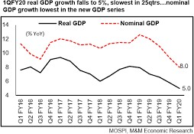
Real GDP controls for Inflation
Changes in nominal GDP can be due to:
changes in prices
changes in quantities of output produced
Changes in real GDP can only be due to changes in quantities, because real GDP is constructed using constant base-year prices.

Slide 11

GDP deflator and Inflation rate
NOW YOU TRY
 | Nominal GDP | Real GDP | GDP deflator |  | Inflation rate
2020 | 462 | 462 |  |  | n.a.
2021 | 514 | 500
2022 | 583 | 520
Compute the GDP deflator in each year.
Use GDP deflator to compute the inflation rate in 2021 and 2022.
12

Slide 12
Answers
NOW YOU TRY
 | Nominal GDP | Real GDP | GDP deflator |  | Inflation rate
2020 | 462 | 462 | 100.0 |  | n.a.
2021 | 514 | 500 | 102.8 |  |  | 2.8%
2022 | 583 | 520 | 112.1 |  |  | 9.1%
Compute the GDP deflator in each year.
Use GDP deflator to compute the inflation rate in 2021 and 2022.
13

Slide 13
Consumer Price Index (CPI) & Inflation Rate
CPI is a measure of the overall level of prices faced by consumers
Uses:
Tracks changes in the typical household’s
cost of living
Adjusts many contracts for inflation e.g. D.A.(dearness allowance)
Used by RBI to decide monetary policy stance (whether to increase or decrease interest rates)

Slide 14
How the CPI is compiled
Consumers surveyed to determine composition of the average consumer’s “basket” of goods with around 450 items
Every month, field investigators collect data on prices of all items in the basket; compute the cost of basket
CPI in any month equals =
_{100 ×} Cost of basket in that month Cost of basket in base period
Current Base year for CPI is 2011-12

Slide 15
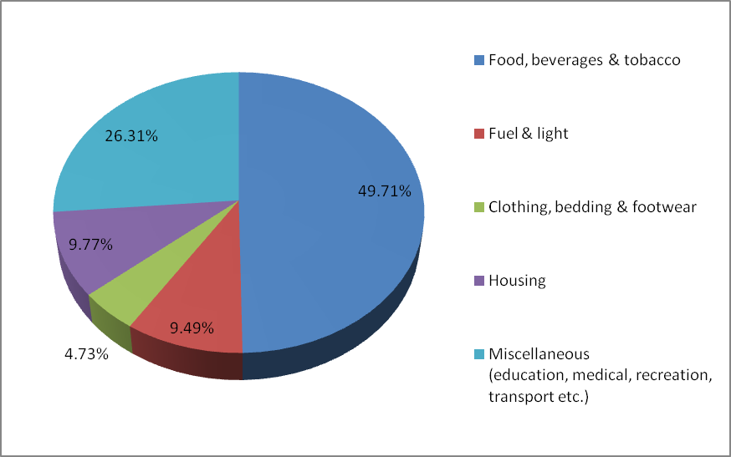
The composition of the CPI’s “basket”

Slide 16

Compute the CPI
NOW YOU TRY
Basket fixed in the base year: 20 oranges, 10 apples
For each year, compute:
the cost of the basket
the CPI (use 2012 as the base year)
the inflation rate
Prices:
oranges
apples
2012 | 10 | 15
2013 | 11 | 15
2014 | 12 | 16
2015 | 13 | 15

Slide 17
Answers
NOW YOU TRY
Cost of basket
Inflation rate
CPI
2012
2013
2014
2015
350
370
400
410
100.0
105.7
114.3
117.1
n.a.
5.7%
8.1%
2.5%
18

Slide 18
Wholesale Price Index (WPI) & Inflation Rate
A measure of the overall level of market prices
Tracks changes in wholesale prices
WPI calculation:
Wholesale prices of 676 items are tracked every week
Composition of the basket depends on the
contribution of each item to value of economic output
WPI in any month equals =
_{100 ×} Cost of basket in that month Cost of basket in base period
Current Base year for WPI is 2011-12

Slide 19
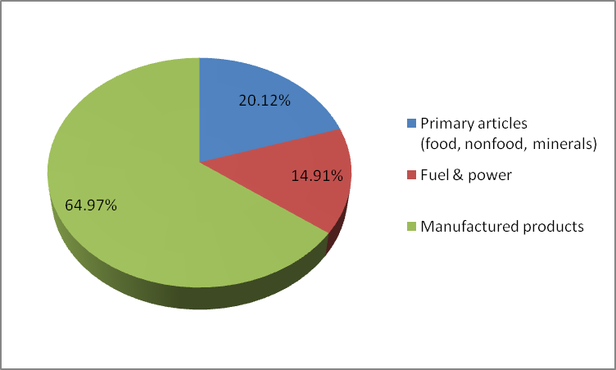
The composition of the WPI’s “basket”

Slide 20
Which is the more reliable Price Index?
Which one is more ‘comprehensive’?
CPI & WPI have a fixed basket, but GDP deflator is more
comprehensive
Which one ignores imported consumer goods?
CPI includes prices of imported consumer goods, ignored by WPI and GDP deflator
Which one ignores services?
CPI includes prices of services, ignored by WPI
However, CPI might overstate inflation by ignoring shift of households to cheaper substitutes

Slide 21
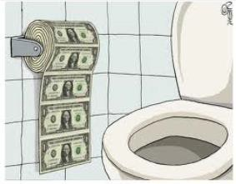
Types of Inflation
Hyperinflation
Extremely high inflation
Deflation
Sustained decrease in price level
Disinflation
Decrease in inflation
Stagflation
A combination of high inflation and low growth (inflation + unemployment)
Notes:
When Inflation occurs, the value of a currency falls continuously – fall in the money value of currency. Because too much money is chasing too few goods.

Slide 22
A few examples of hyperinflation
Country | Period | CPI Inflation % per year | Money Supply Growth % per year
Israel | 1983-85 | 338% | 305%
Brazil | 1987-94 | 1,256 | 1,451
Bolivia | 1983-86 | 1,818 | 1,727
Ukraine | 1992-94 | 2,089 | 1,029
Argentina | 1988-90 | 2,671 | 1,583
Dem. Republic of Congo / Zaire | 1990-96 | 3,039 | 2,373
Angola | 1995-96 | 4,145 | 4,106
Peru | 1988-90 | 5,050 | 3,517
Zimbabwe | 2005-07 | 5,316 | 9,914

Slide 23
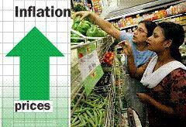
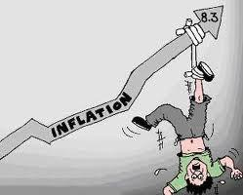
Why is Inflation unpopular?
Higher prices erodes our purchasing power
But higher prices also translates into higher
income
But nominal income may not keep up with inflation leading to lower real income
People suffer from “Money illusion”
‘Dosa Economics’ by Raghuram Rajan:
https://www.youtube.com/watch?v=N9NBTAmta
PY
Other effects of inflation:
Creditors lose, but debtors gain
Uncertainty creates ‘menu costs’
Notes:
Menu Costs – continuous changes in prices results in creating new menus showing current prices every now & then.

Slide 24
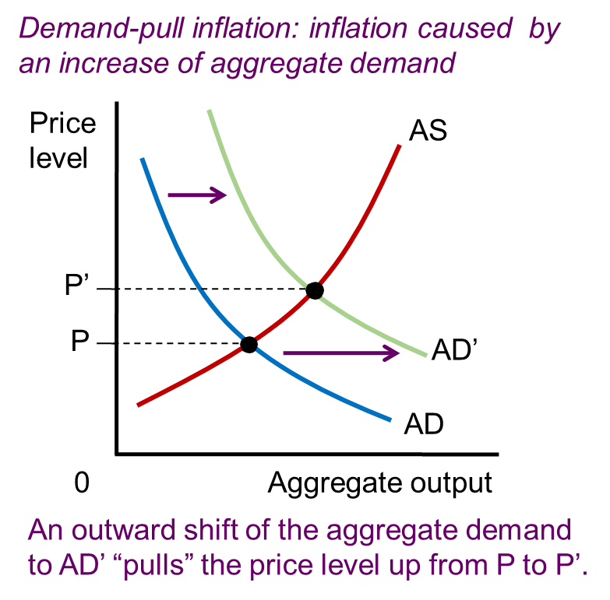
Sources of Inflation
Increase in Demand
Demand-pull inflation
Rapid growth in
money supply
Increased
government spending
Social programs
Notes:
AD = Aggregate Demand

Slide 25
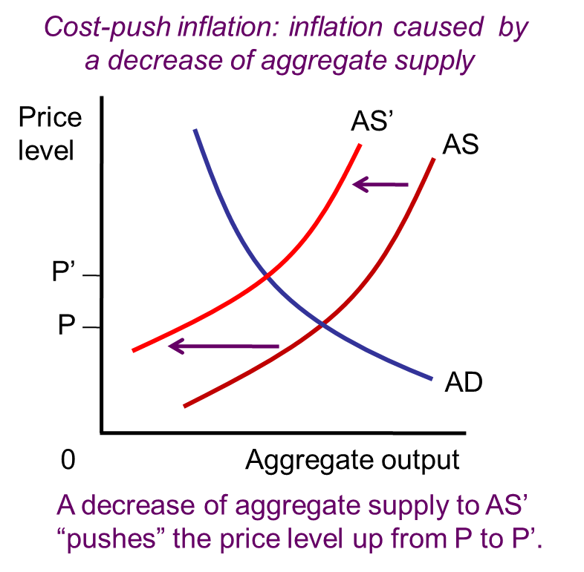
Sources of Inflation
Decrease in Supply
Cost-push inflation
Higher cost of production
Pushes up the price
level
Associated with
stagflation
Notes:
AS = Aggregate Supply

Slide 26
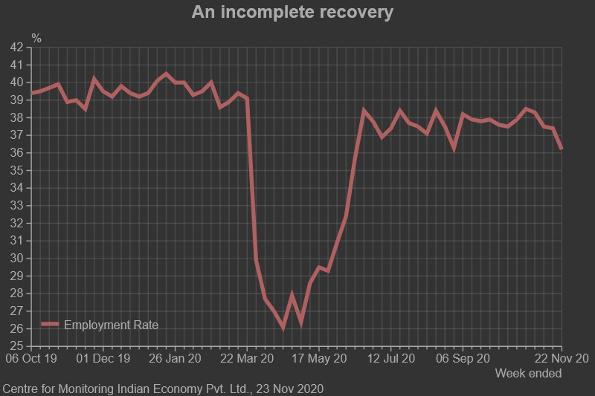
Employment rate Post pandemic

Slide 27
“Labour Markets in distress": Mahesh Vyas (CMIE)
https://cmie.com/kommon/bin/sr.php?kall=warticle&dt=20220930174813&msec=056&ver=pf Date: 23 Nov 2020; Article on CMIE
Labour markets have been weakening in the last four weeks. The labour participation rate and the employment rate have fallen in each of these. The unemployment rate has bounced between 5.5 per cent and 7.8 per cent with an average of 6.8 per cent.
But, this is almost inconsequential. What is important is that the labour markets were unable to absorb adequate proportions of the working age population during the festive season of 2020.
Labour participation touched a recent peak of 41.3 per cent in the week ended October 25. Since then, it has slid in each of the following four weeks. Note that this recent peak of 41.3 per cent itself is very low. Labour participation had reached 42 per cent in June during its recovery from the fall in April and May.

Slide 28
Mahesh Vyas’s article…
A falling LPR (labour force participation rate) implies that an increasingly smaller proportion of the working age population is seeking employment. In absolute terms, the LPR translates into the labour force. If the LPR continues to fall sharply, the labour force shrinks. This is what happened in September 2020 after the recovery process lost steam. The labour force stagnated in October. It could be falling in November. This is worrisome. The unemployment rate is the proportion of the labour force that fails to find employment.
In the week ended November 22, 7.8 per cent of the labour force could not find employment. This is much higher than the 5.5 per cent unemployment rate penciled in the preceding week. Or, compared to any of the preceding four weeks when the unemployment rate hovered between 5.5 per cent and 7.2 per cent. The sharp rise of the unemployment rate is against the trend seen since the recovery began. The trend has been one of falling unemployment rates with an occasional spike. This happened during the first fortnight of October 10.

Slide 29
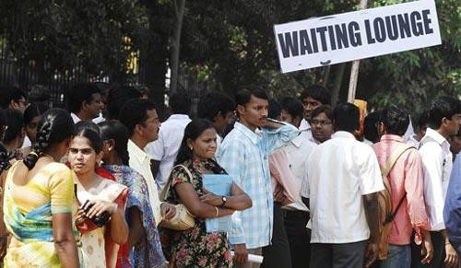
Measuring Unemployment
National Sample Surveys try to estimate the following categories of the population:
employed
working at a paid job
unemployed
not employed but looking for job
labor force
all employed plus unemployed persons
not in the labor force
not employed, not looking for work
for a

Slide 30
Two important labor force concepts
Unemployment rate
percentage of the labor force that is unemployed
Labor force participation rate (LPR)
the fraction of the population that “participates” in the labor force,
i.e. is working or looking for work

Slide 31

Computing labor statistics
NOW YOU TRY
Population by group, 2001
Number of employed (E) | = | 337 million
Number of unemployed (U) | = | 27 million
Population (POP) | = | 1025 million
Use the above data to calculate:
the labor force (L)
the number of people not in the labor force (NILF)
the unemployment rate
the labor force participation rate

Slide 32
Answers
NOW YOU TRY
data: E = 337, U = 27, POP = 1025
labor force
L = E + U = 337 + 27 = 364
not in labor force
NILF = POP – L = 1025 – 364 = 661
unemployment rate
U/L x 100% = (27/364) x 100% = 7.4%
labor force participation rate
L/POP x 100% = (364/1025) x 100% = 35.5%

Slide 33
Unemployment rate: Some omissions
Under-employment
Time: Workers who would prefer to work more hours Skill: Workers Skills are mismatched with jobs
Discouraged workers: Given up looking for job;
Both unemployment rate and LFPR falls

Slide 34
Equilibrium in the Labor Market
The labor demand and labor supply curves describe the national labor market.
The intersection of the curves identifies the market equilibrium.
The labor market in equilibrium
At equilibrium, there is a stable wage (price) and amount of labor bought and sold.
The equilibrium does not
explain unemployment.
Wage
Labor supply
W*
Labor demand
L*
Labor

Slide 35
The labor market with Unemployment
Unemployment occurs when the wage rate is higher than the equilibrium wage.
The labor market with unemployment
Wage
Workers are willing to provide more labor than firms are willing to hire.
The labor market has a
surplus of workers.
Labor
supply
Unemployment
W
1
W*
Labor demand
L_{D}
L*
L _{S}
Labor

Slide 36
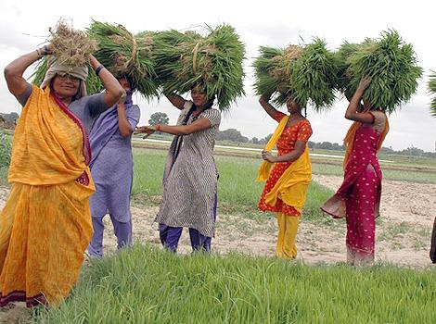
Sources (Types) of Unemployment
Frictional unemployment
Time required to bring together
employers and job seekers
Doesn’t last long and policy
makers are usually not concerned
Seasonal unemployment
Examples: Demand for farm
workers, construction workers
Policy makers are usually not concerned

Slide 37
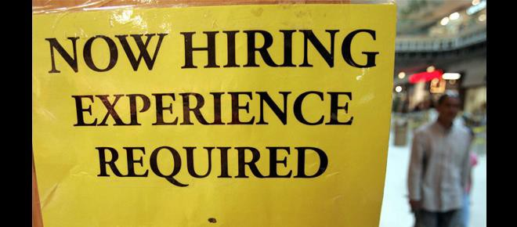
Sources of Unemployment
Structural unemployment
Mismatch of skills or geographic location
Some skills become obsolete
Cyclical unemployment
Increases during recessions
Temporary feature of developed countries but persistent in poor
countries
“Full employment” can be achieved by macroeconomic policy by eliminating cyclical unemployment but other sources (frictional, seasonal, structural) will remain – that is called the natural rate of unemployment

Slide 38
How does LFPR fall reflect in Unemployment rate:
An interesting case
https://www.financialexpress.com/economy/indias-low- unemployment-rate-gives-no-reason-to-cheer-workers-prefer-to-sit- out-of-job-market/2090657/
This is however a concern for policy makers. It gives a wrong picture about the employment situation of the economy.
Unemployment fell for an unhealthy reason: people stopped looking for work.

Slide 39
India’s Unemployment Challenges
https://www.youtube.com/watch?v=1nBpWRr_uVE
Can you suggest some economic policies to bring unemployment down?
https://apnews.com/article/india-population-women-workforce- 2fa5974bab63d56c8bc2ba386d67d91e

